Slide 1
Climate Risk Adjusted Reinsurance
By Gopalakrishnan Kumar, MTech IIT-Bombay,
Freelance Data Science Consultant
LinkedIn: Profile Link : https://www.linkedin.com/in/gopalakrishnankumar-a73301110/
Github:https://www.github.com/Gopalakrishnan-Kumar/
Kaggle URL- https://www.kaggle.com/gopalkk2

Slide 2
Google Colab URL
https://colab.research.google.com/drive/1tMxfxPuKpw3Ku3Sc7qBZuqzCbteAgVWe?usp=sharing

Slide 3
Introduction
Climate change has significantly increased the frequency and severity of natural disasters such as floods, cyclones, droughts, and storms. These climate-related events create substantial financial risks for insurance companies and reinsurers. Traditional reinsurance pricing models often rely on historical loss data; however, such approaches may underestimate emerging climate risks. Therefore, insurers are increasingly adopting climate risk-adjusted reinsurance models to better assess exposure and manage catastrophe risk.

Slide 4
Introduction
The objective of this project is to develop a data-driven analytical framework that integrates climate risk indicators into insurance claim probability and severity estimation. Using Python-based data analytics and visualization techniques, this project simulates an insurance portfolio across multiple regions and policy types. The study then evaluates how climate risk factors influence claim occurrences and claim amounts.
Through the application of histograms, bar charts, stacked bar charts, and combined stacked bar charts, the project provides a comprehensive understanding of climate-adjusted insurance losses and portfolio exposure across different regions.

Slide 5
Dataset Description
The dataset used in this analysis is a simulated insurance portfolio representing multiple policyholders across geographically diverse regions. The dataset includes the following key variables:
Region – Geographic location where the policyholder resides (Coastal, River Basin, Urban, Semi-Urban, Rural).
Policy Type – Type of insurance coverage such as Property, Crop, Health, or Commercial insurance.
Premium – Annual premium paid by the policyholder.
Base Sum Insured – Maximum coverage amount provided by the insurer.

Slide 6
Dataset Description
Base Claim Probability – Probability of a claim occurring based on traditional underwriting models.
Climate Risk Index – A risk score assigned to each region representing exposure to climate hazards.
Adjusted Claim Probability – Claim probability recalculated after incorporating climate risk.
Claim Occurred – Binary indicator representing whether a claim occurred.
Climate Adjusted Claim – Final claim amount adjusted based on climate risk severity.
The Climate Risk Index plays a central role in this model by modifying the base claim probability and claim severity to reflect environmental exposure.

Slide 7
Methodology
The analytical methodology consists of the following steps:
Step 1: Data Simulation A synthetic dataset was generated using Python libraries such as NumPy and Pandas. This dataset mimics a real-world insurance portfolio containing 1000 policyholders across multiple regions.
Step 2: Climate Risk Adjustment Each region was assigned a climate risk score representing environmental vulnerability. Coastal and river basin regions were assigned higher risk values due to exposure to floods, storms, and cyclones.

Slide 8
Methodology
Step 3: Claim Probability Adjustment The base claim probability was adjusted using the formula:
Adjusted Claim Probability = Base Claim Probability × (1 + Climate Risk Index)
This approach increases the likelihood of claims in climate-sensitive regions.
Step 4: Claim Simulation Using a binomial distribution, claim occurrences were simulated based on the adjusted probability.

Slide 9
Methodology
Step 5: Claim Severity Calculation Claim amounts were calculated by multiplying the insured value with a climate severity multiplier influenced by the regional risk index.
Step 6: Data Visualization Multiple visualization techniques were used to interpret the portfolio risk structure.

Slide 10
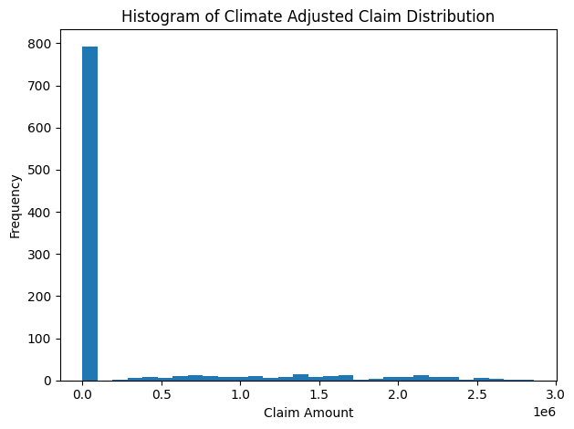
Data Visualization

Slide 11
Data Visualization and Analytics
Histogram Analysis
The histogram illustrates the distribution of climate-adjusted claim amounts. Most claims fall within lower claim ranges, indicating that small claims occur frequently. However, the distribution also contains a long tail representing large catastrophic losses. This pattern reflects typical insurance risk structures where high-severity low-frequency events dominate catastrophic risk.

Slide 12
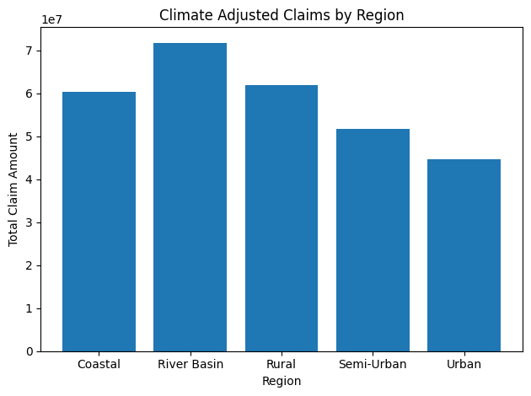
Data Visualization

Slide 13
Data Visualization and Analytics
Bar Chart Analysis
The bar chart compares total climate-adjusted claims across regions. Regions with higher climate exposure, such as coastal and river basin areas, show significantly higher claim totals. This indicates that insurers operating heavily in these regions may experience greater loss volatility.

Slide 14
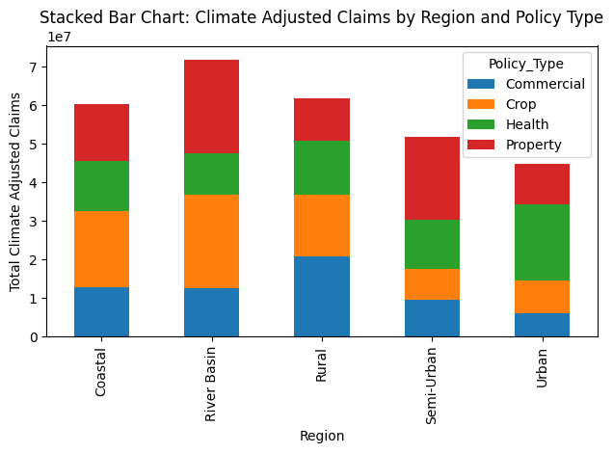
Data Visualization

Slide 15
Data Visualization and Analytics
Stacked Bar Chart Analysis
The stacked bar chart breaks down claims by region and policy type. This visualization helps insurers understand which types of policies contribute most to climate-related losses.
For example:
Crop insurance claims may dominate in river basin regions due to flood exposure.
Property insurance claims may dominate in coastal regions due to cyclone damage.
This analysis helps insurers adjust underwriting strategies and pricing structures accordingly.

Slide 16
Data Visualization
Combined Stacked Bar Chart Analysis
The combined stacked bar chart compares total premiums collected versus climate-adjusted claims across regions. This visualization highlights the financial balance between revenue and potential losses.
If claims significantly exceed premiums in certain regions, it indicates a potential underwriting imbalance, requiring pricing adjustments or reinsurance support.

Slide 17
Business Applications
The climate risk-adjusted reinsurance model provides several practical benefits for insurance companies and reinsurers:
Risk-Based Pricing Insurers can adjust premiums based on regional climate exposure to ensure sustainable underwriting profitability.
Improved Reinsurance Structuring Reinsurers can use climate-adjusted models to design more effective catastrophe treaties.
Portfolio Diversification Companies can rebalance their portfolios by reducing concentration in high-risk climate zones.

Slide 18
Business Applications
Capital Allocation Optimization Insurers can allocate reserves more efficiently based on expected climate-related losses.
Catastrophe Risk Management Advanced analytics help insurers anticipate extreme events and mitigate financial impact.

Slide 19
Conclusion
Climate change presents a growing challenge for the insurance industry. Traditional underwriting models may fail to capture the full impact of environmental risk, leading to underpriced policies and unexpected losses.
This project demonstrates how Python-based data analytics and visualization techniques can be used to incorporate climate risk into reinsurance decision-making. By adjusting claim probabilities and claim severities using regional climate risk indicators, insurers can better estimate portfolio risk exposure.

Slide 20
Conclusion
The visualizations developed in this project provide actionable insights for insurers, helping them understand the distribution of losses, regional risk concentrations, and the relationship between premiums and claims.
Ultimately, climate risk-adjusted reinsurance models enable insurers to build more resilient portfolios, improve pricing accuracy, and enhance long-term financial stability in the face of increasing environmental uncertainty.

